Slide 1
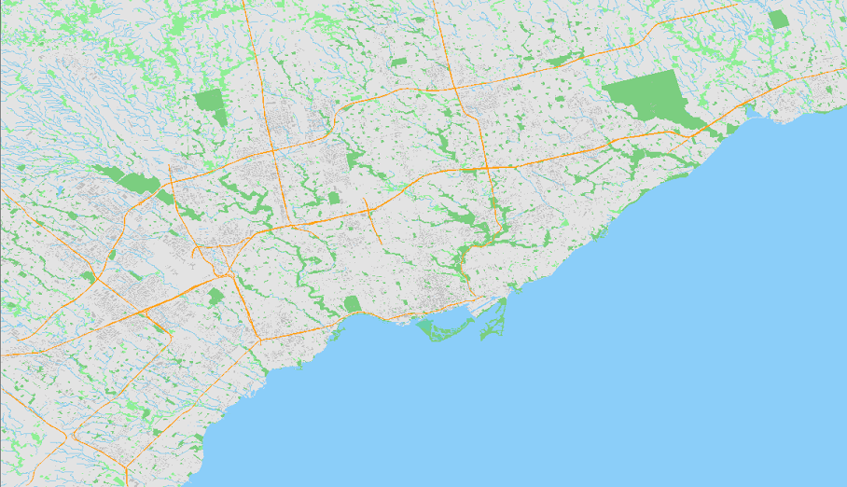
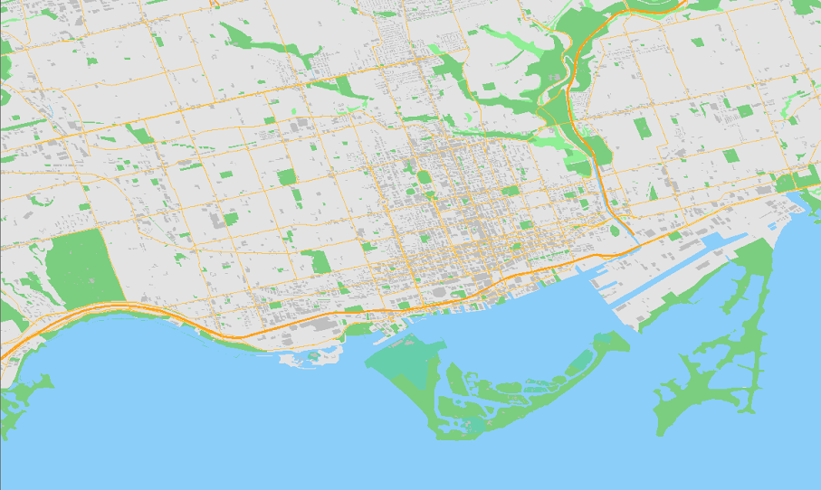
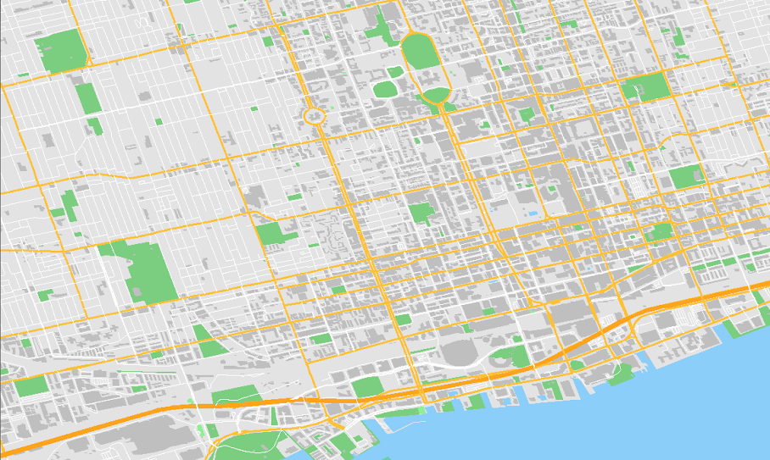
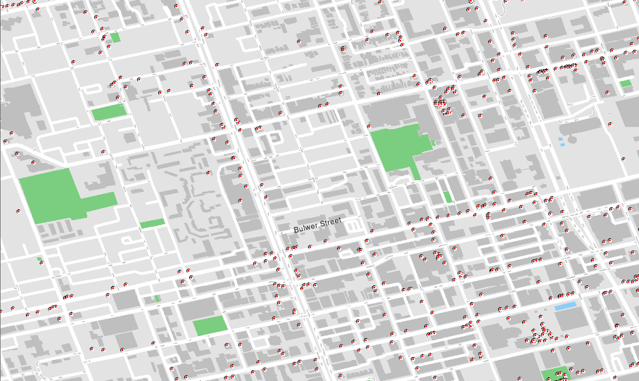
Final Presentation Team: 096
ECE297: Communication and Design
The Team:
Shiyao Chen
Margaret Riese

Slide 2
Overview
Geographic Information Systems are a vital link or bridge between people and geographic information they may need
Major Visual Aspects
Colour Choices, Points of Interest & Path Highlighting
‘Sort By’ Function & Algorithms Used
Future Pitch
Motivations Behind Design
Demonstration
Take-Away

Slide 3
Major Visual Aspects
Key Design Features

Slide 4
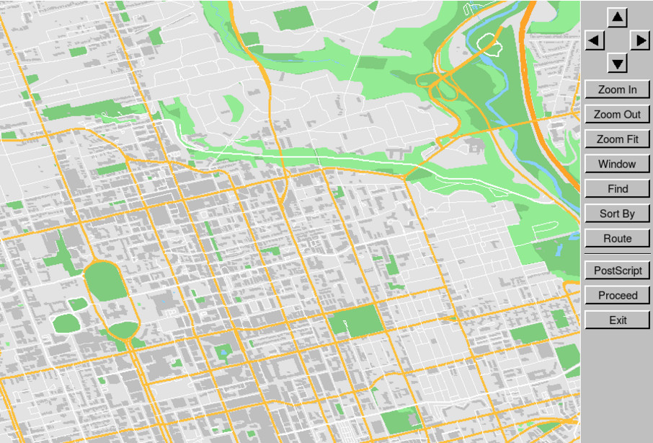
Color Choices

Slide 5

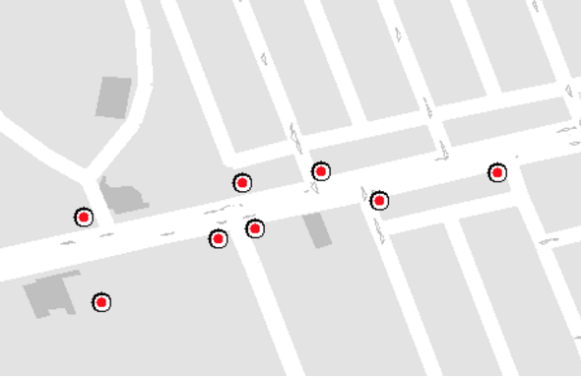

Points of Interest
Computer mouse on a white background
Computer mouse on a black background
Points of interest stickers

Slide 6
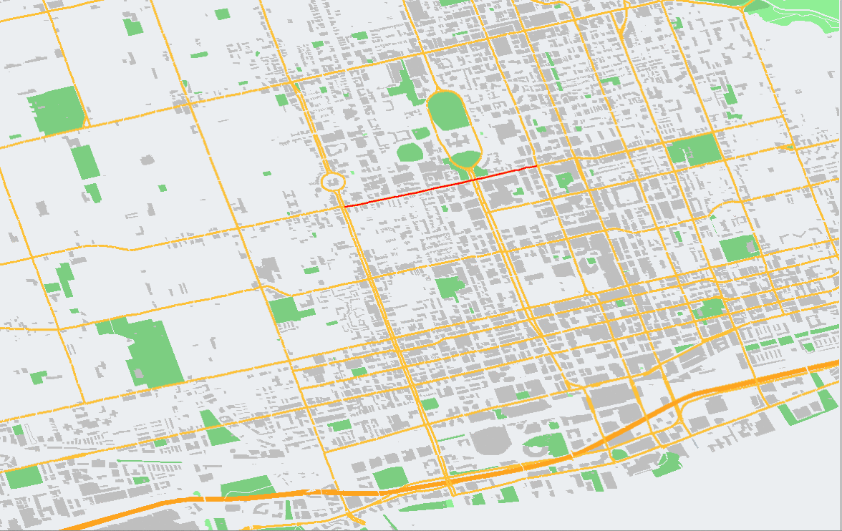
Path Highlighting

Slide 7
Major Visual Aspects
Key Innovations

Slide 8
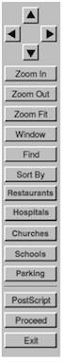
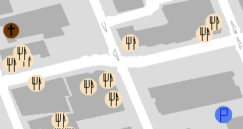
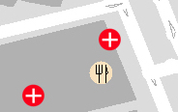

‘Sort By’ Feature

Slide 9
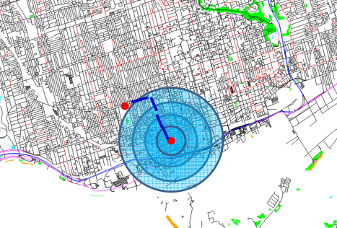
Algorithms Used
Betz, Vaughn. "Lecture 15: Breadth-First Search". 2016. Lecture.

Slide 10
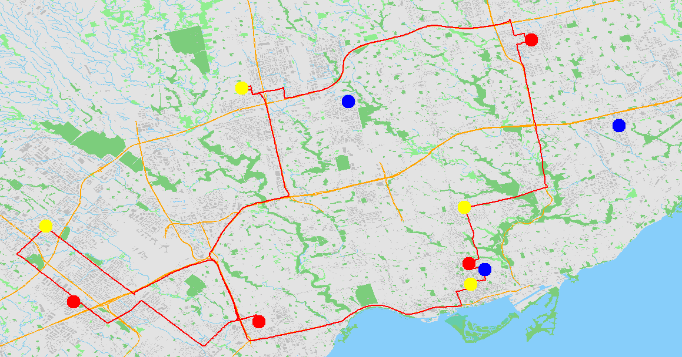
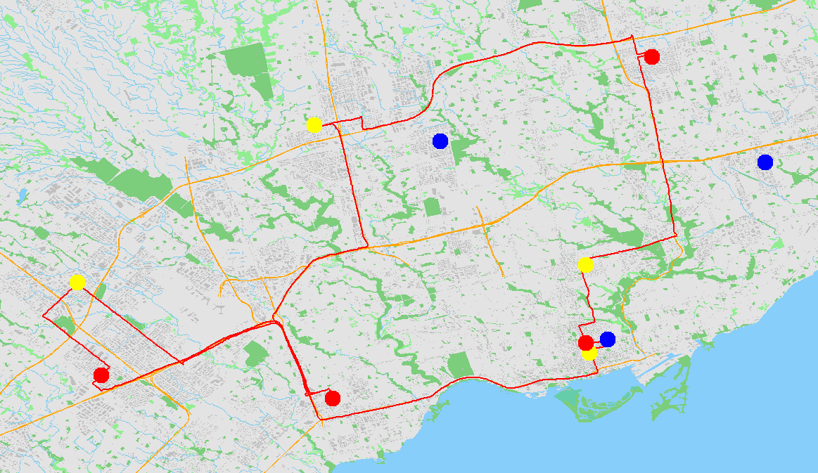
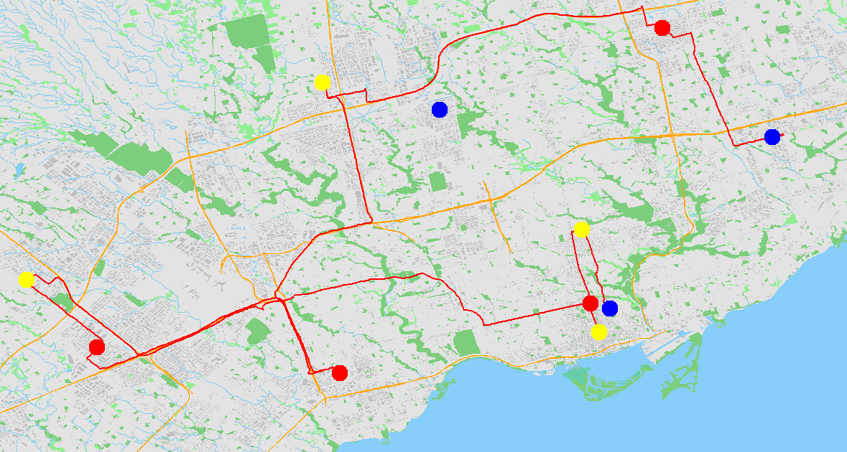
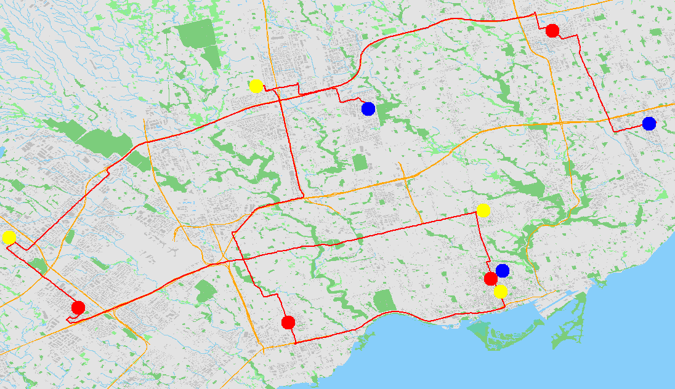
Greedy
Greedy + Iterative Improvement
Greedy + Multistart
Greedy + Iterative Improvement + Multistart

Slide 11
Algorithms Used | Average QoR for Hard and Extreme Cases
Greedy | 1613.43
Greedy + Iterative Improvement | 1606.07
Greedy + Multistart | 1584.93
Greedy + Iterative Improvement + Multistart | 1578.90

Slide 12
User Feedback
“The way you’ve drawn the map is really clear, it’s clear what everything is” – Eric Huang – Biochemistry
“The [sort by] stickers look good” – Matthew Caruso – Electrical and Computer Engineering
“…It’s confusing because I don’t know where the terminal is...” – Tiffanie Louie - Nursing

Slide 13
Future Pitch
Motivations Behind Design & Demonstration

Slide 14
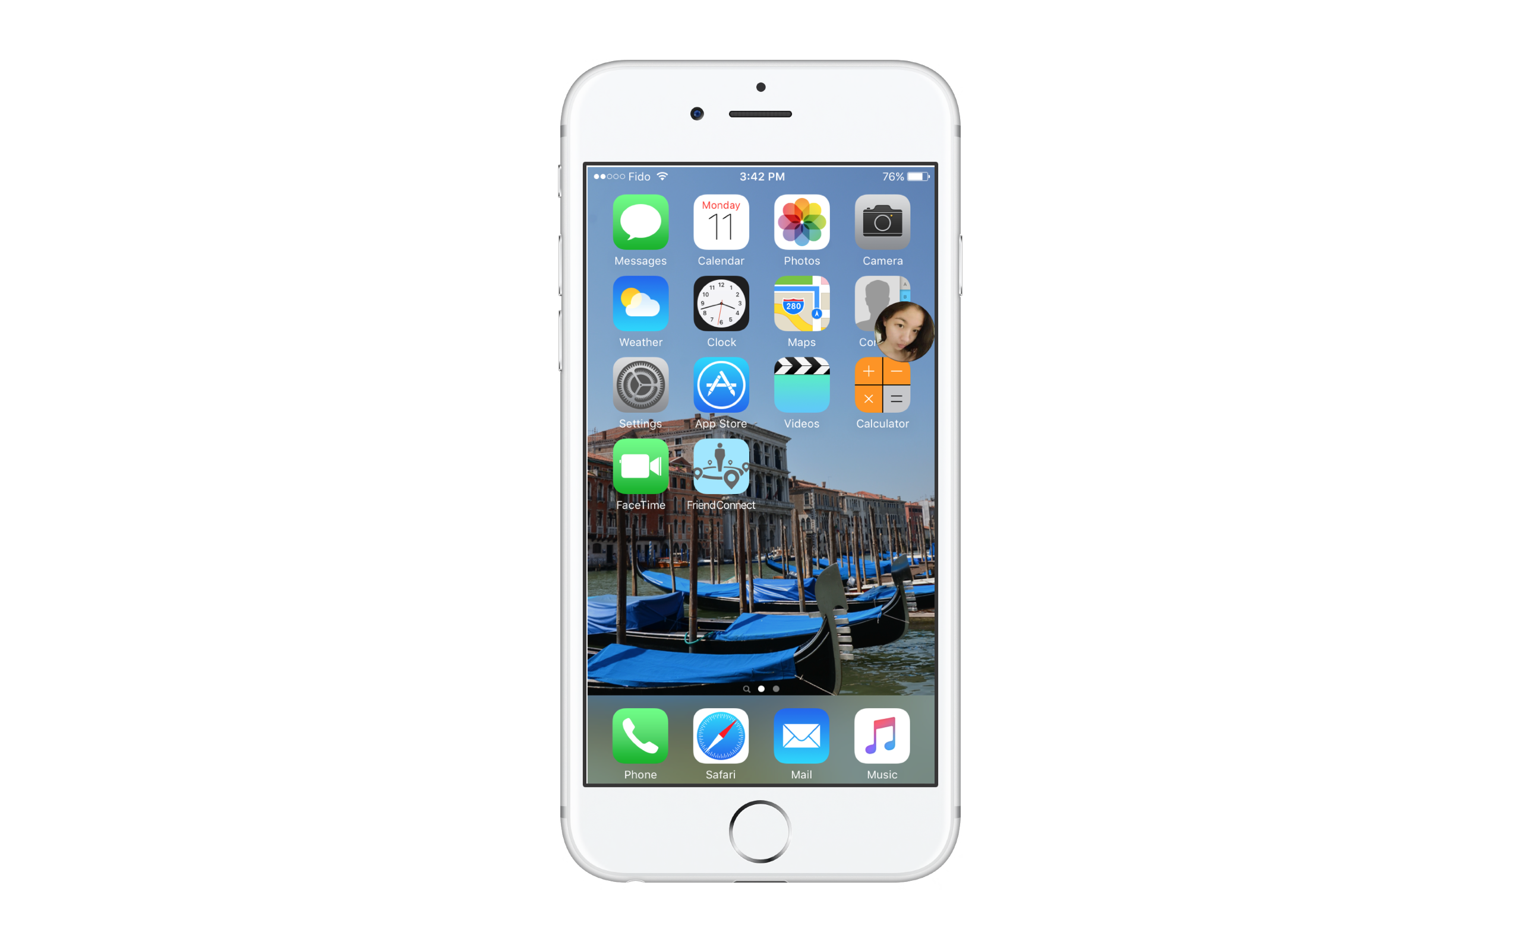

Slide 15
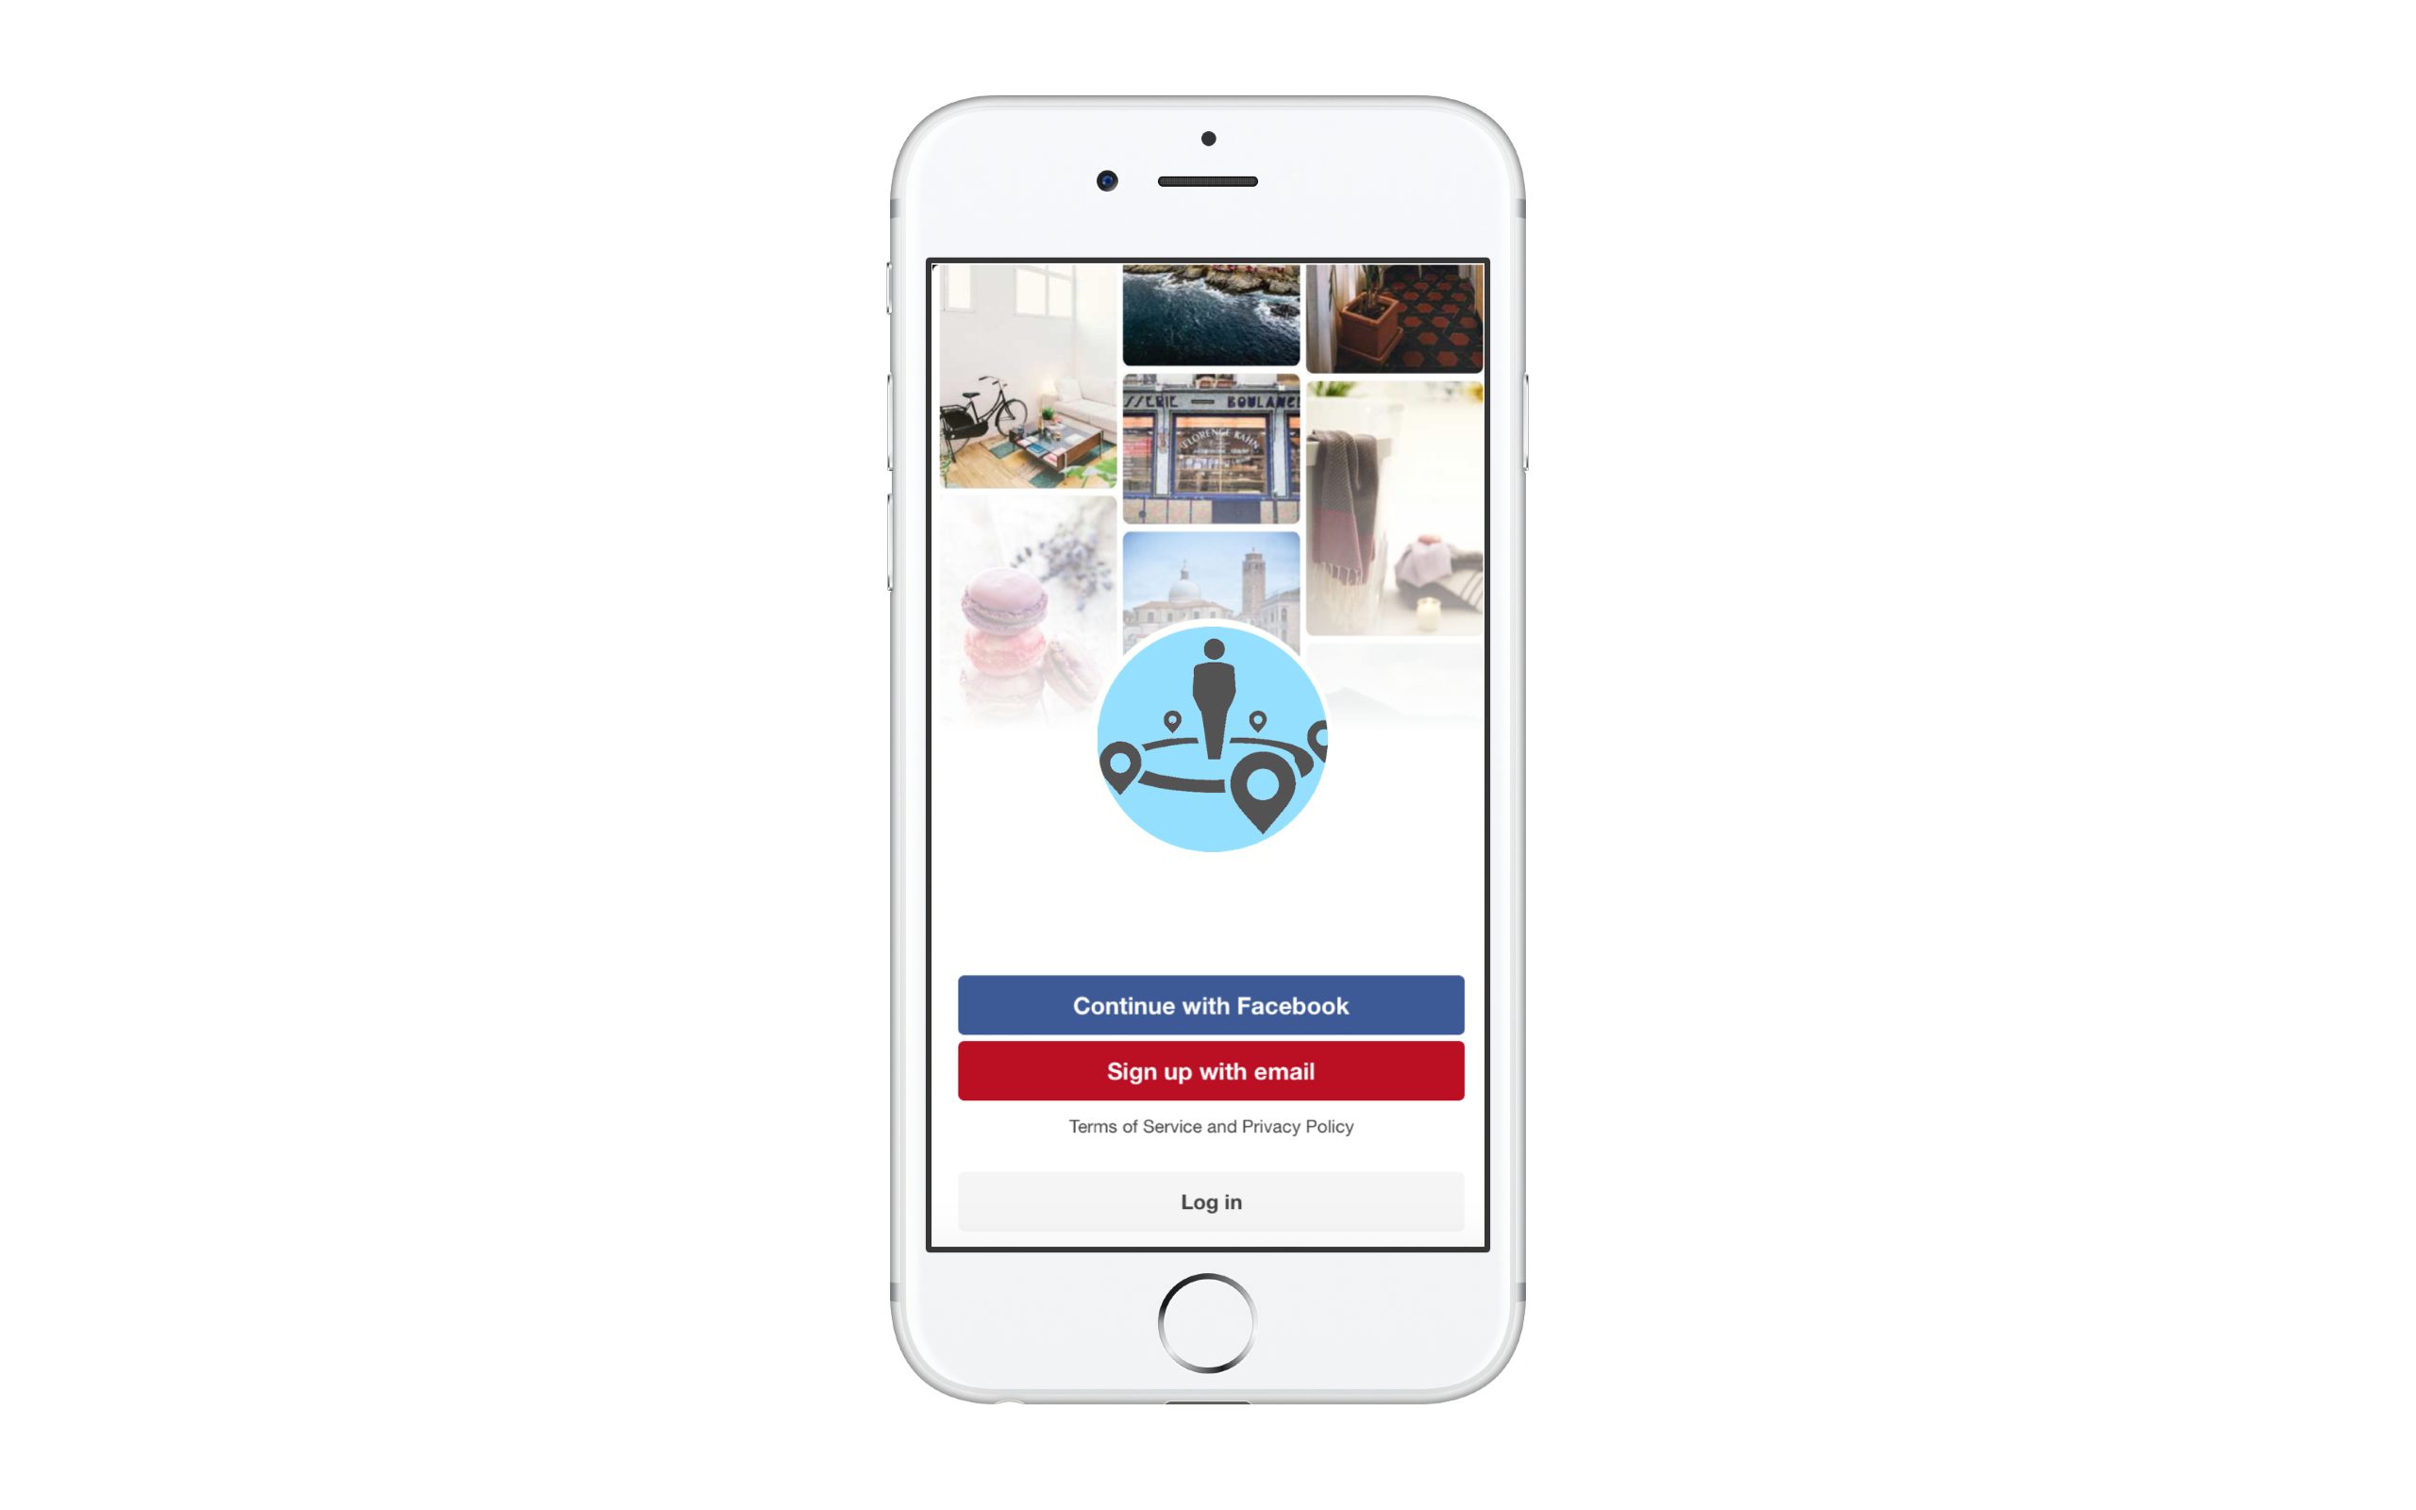

Slide 16
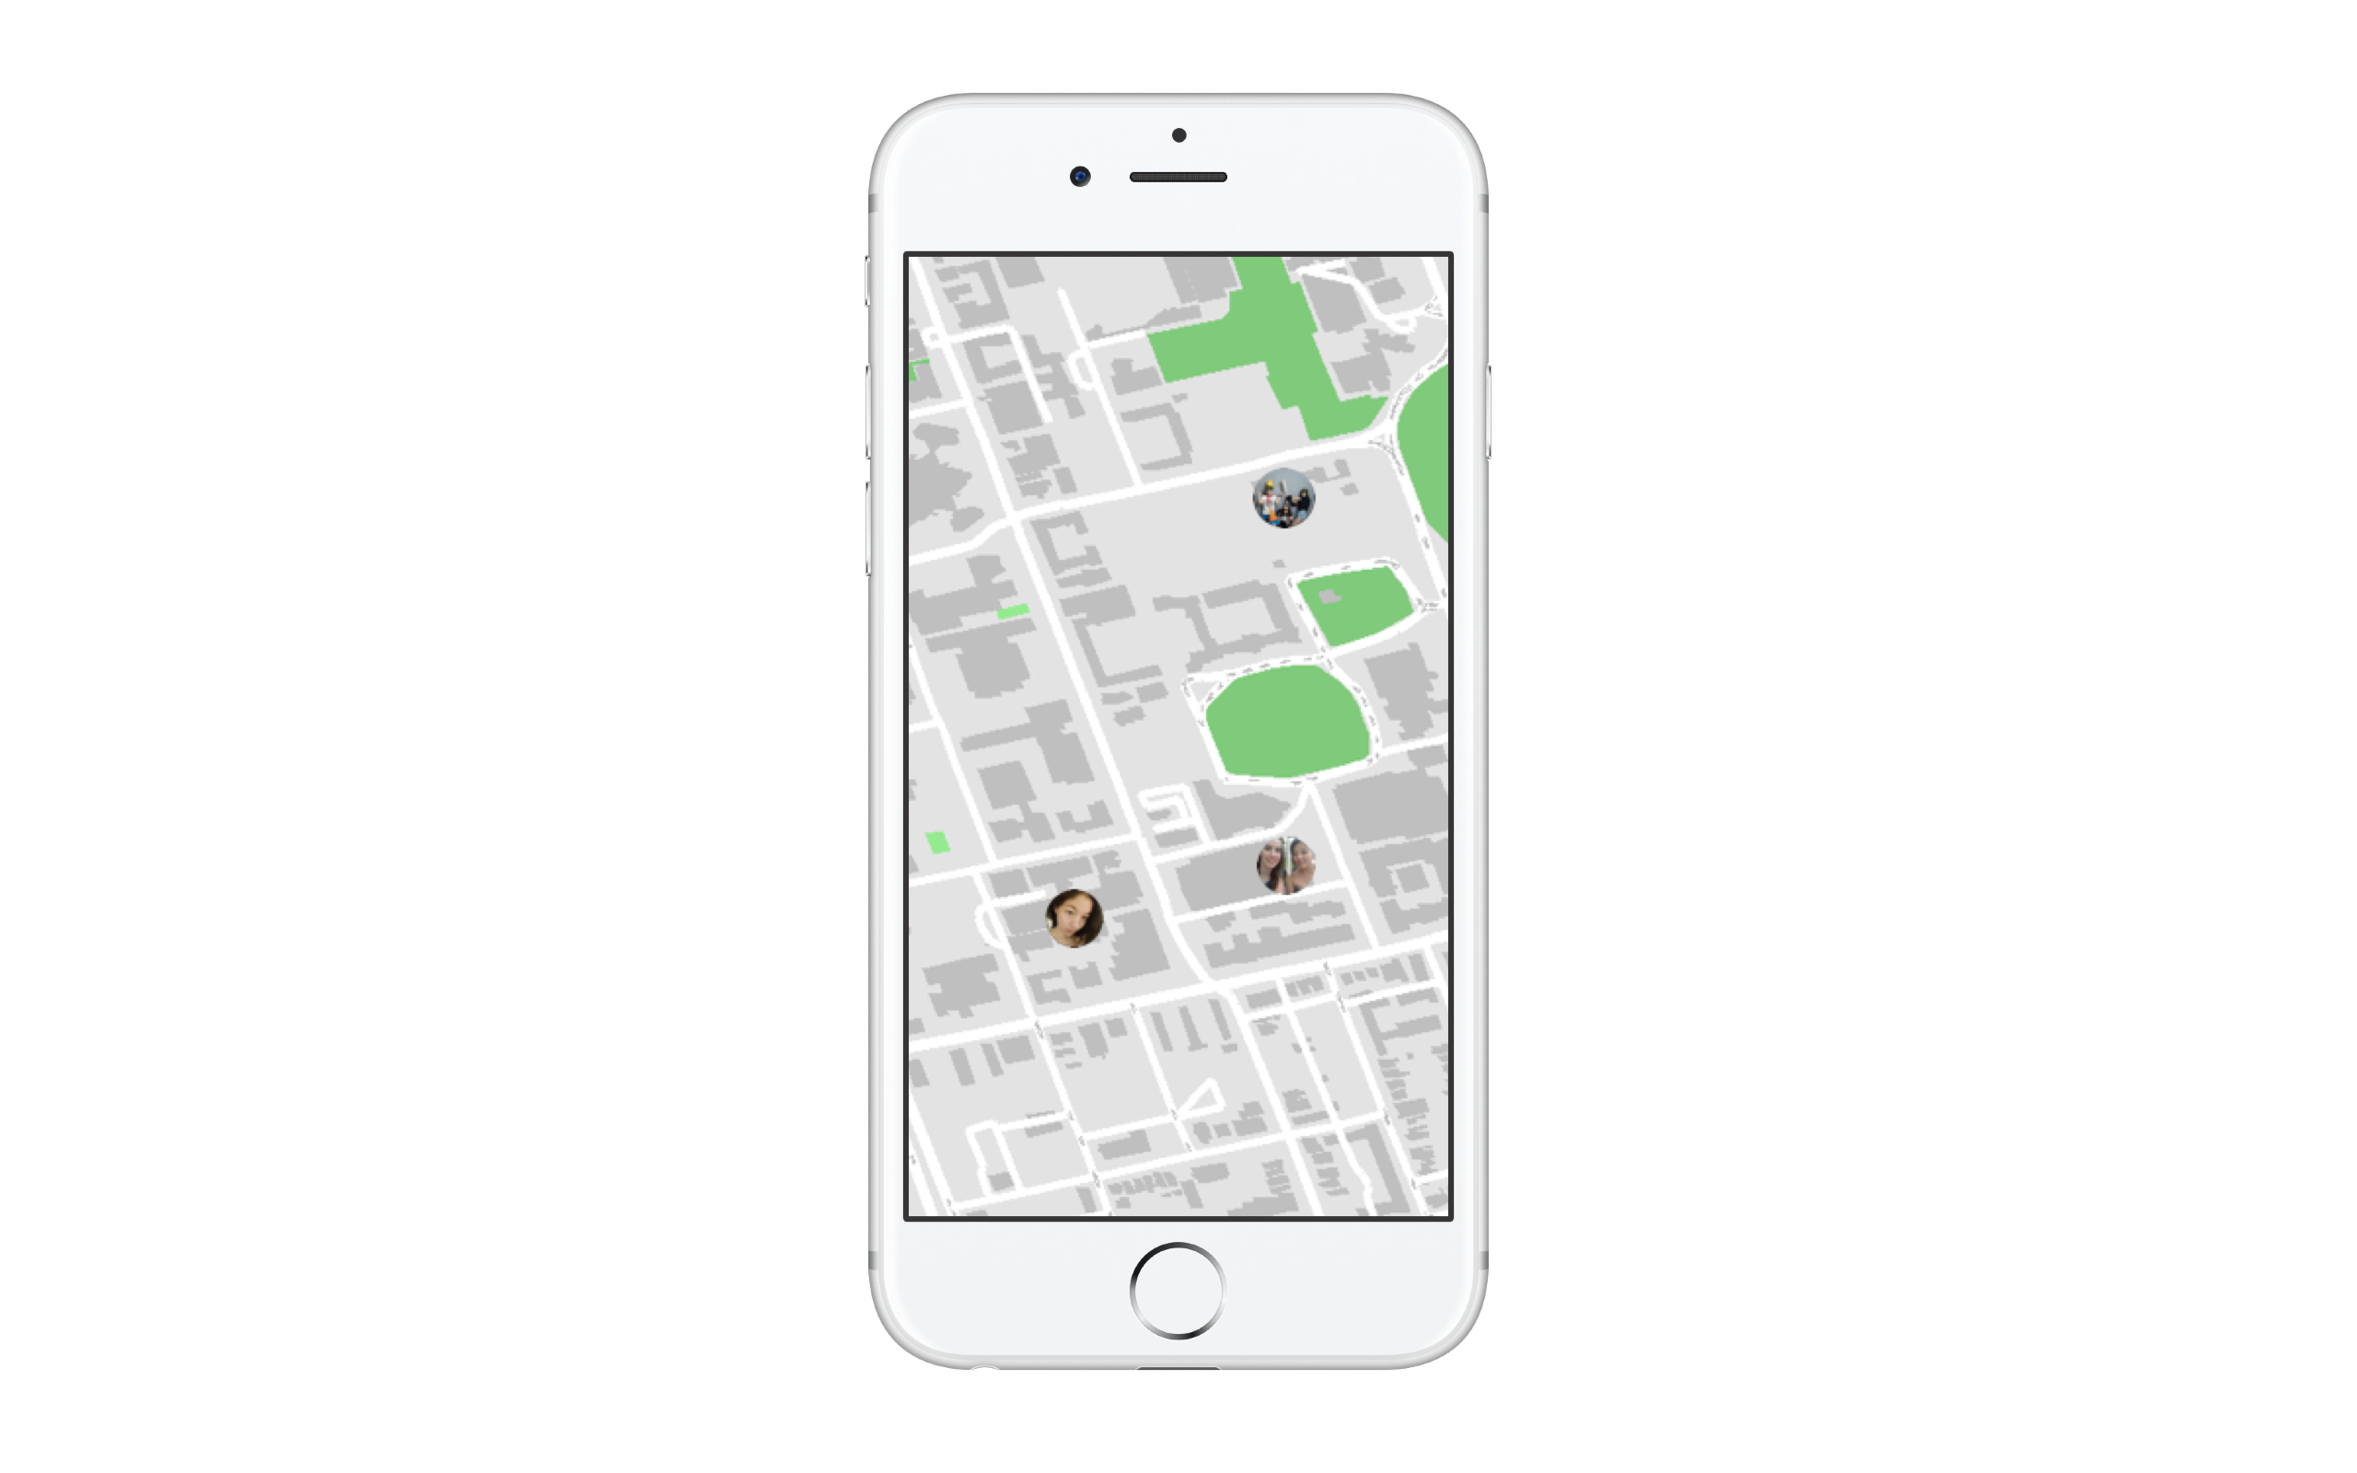

Slide 17
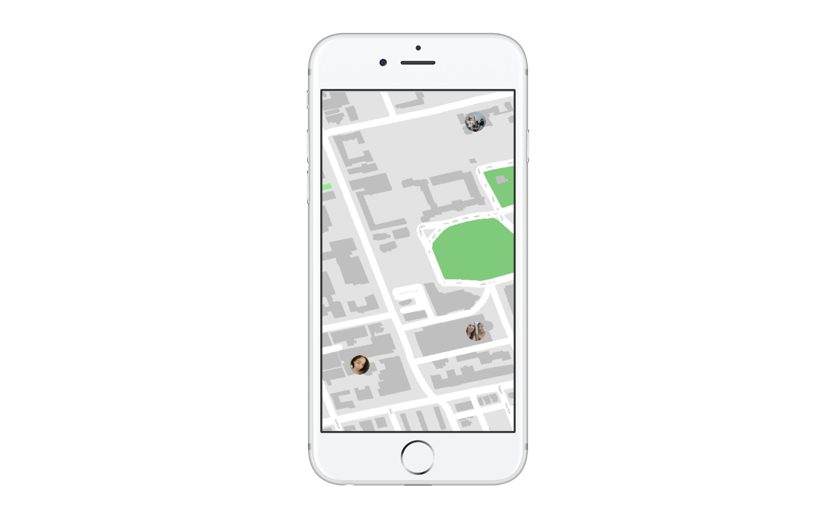

Slide 18
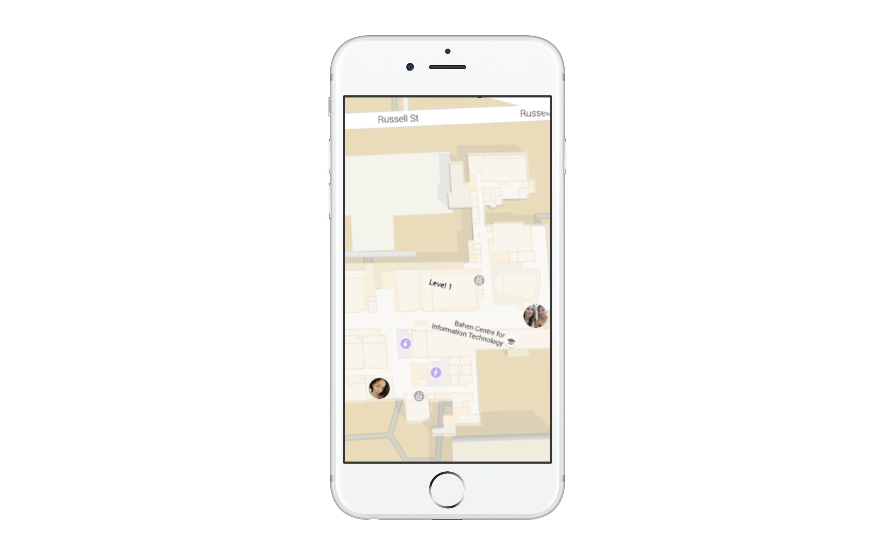

Slide 19


Slide 20
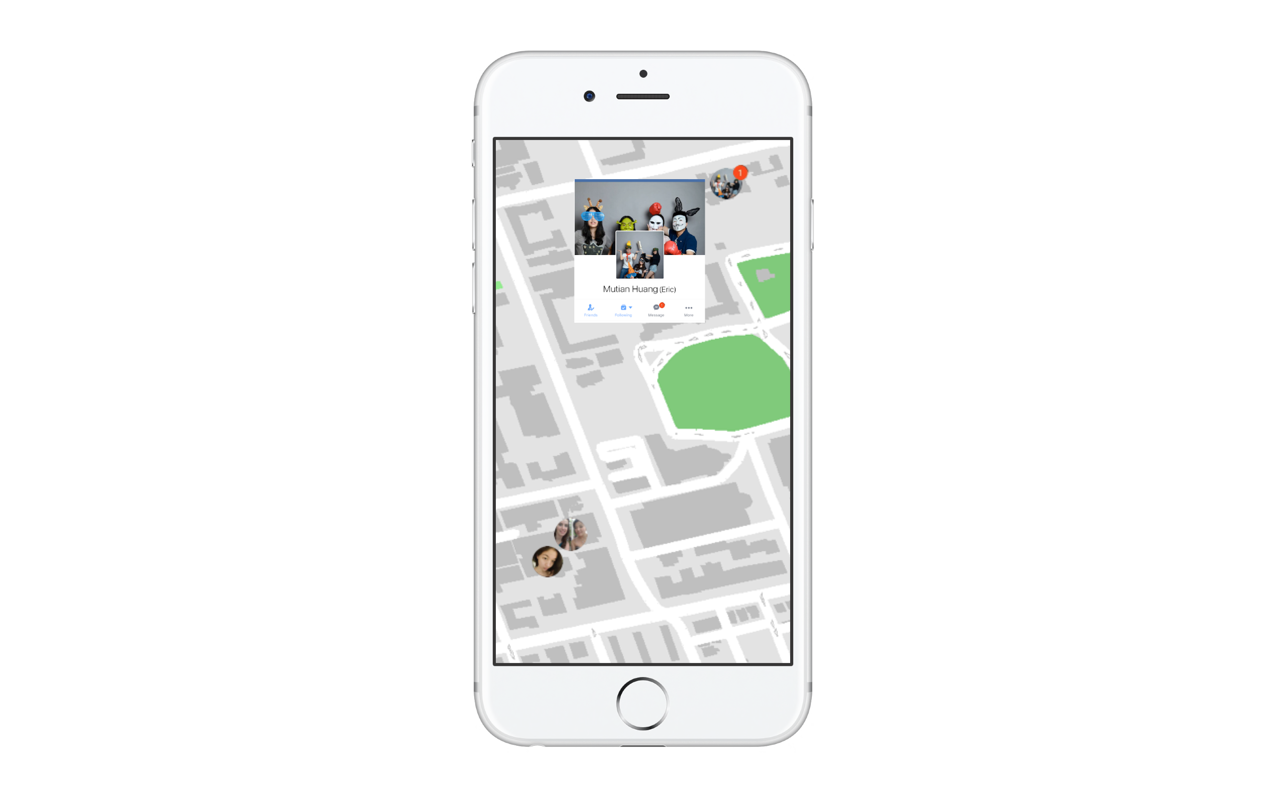

Slide 21
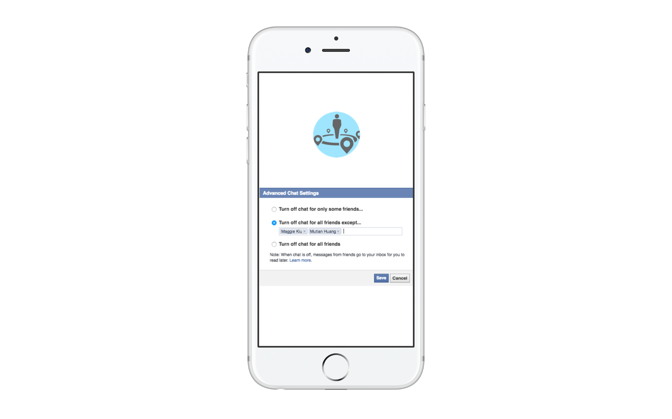

Slide 22
Take-Away
A Simple & Intuitive Bridge

